Slide 1
WGRDBES GOV ISSG Data Quality
Presentation for RDBES-INTRO
Karolina Molla Gazi
Ana Cláudia Fernandes

Slide 2
Why was the ISSG Quality formed?
Need for a Quality check system and workflow of data submitted to RDBES for data submitters and end-users
Tasks:
To develop a plan to integrate quality procedure, taking into account three levels of quality checks.
To start developing further the Data Quality report for data submitters
To present the concept, roadmap and a draft Data Quality Report, at the RCG NANSEA & Baltic Technical Meeting in June, asking the RCG for feedback and endorsement on this.
The draft data Quality Report will also be presented to the WKQuality to see where it fits in the total approach of ICES quality procedure.

Slide 3
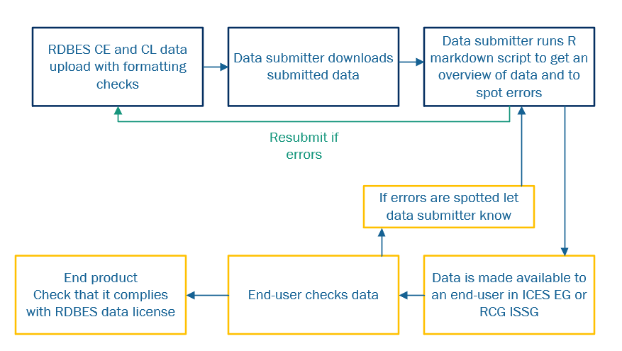
Task 1: To develop a plan to integrate quality procedure, taking into account three levels of quality checks.
RDBES data upload checks
  Format
  Codes
  Duplicates

Slide 4
Task 1: To develop a plan to integrate quality procedure, taking into account three levels of quality checks.
Data Quality report for data submitter
  Completeness
  Outliers
  Cross checks

Slide 5
Task 1: To develop a plan to integrate quality procedure, taking into account three levels of quality checks.
End users
  Thorough checks relating to the use of data
  Feedback if errors are spotted

Slide 6
Task 1: To develop a plan to integrate quality procedure, taking into account three levels of quality checks.
How to QA the data in order to minimize the errors for the end - users?
How to document the changes in the data while considering the dynamic nature of RDBES?
How to ensure feedback when errors are spotted is fast, simple and reaches the data submitters on time?
Timeline
  When do we want the process ready?
  Interim goal and long-term goal.

Slide 7
Task 1: To develop a plan to integrate quality procedure, taking into account three levels of quality checks.
How to QA?
System | User | Pros | Cons
R markdown HTML report | Data submitter | Low cost Easy to develop Short term | R knowledge Dedicated subgroup for maintenance, development Use is optional Directed mainly to data submitter
RDBES automated report | Data submitter | Automatic R knowledge not needed User will have instant access to the report with the data upload | ICES needs to develop it Funding Integrating changes might be difficult Long term Directed mainly to data submitter
Dedicated Working Group | Data submitter & end-users | Thorough checks Could be combined with existing ISSGs/WGs to reduce workload (e.g., Fisheries Overviews) Checks will cover the data submitter and end user needs | Funding Expert capacity Annual Working Group
R package | Data submitters & end users | Checks will cover the data submitter and end user needs Easily accessible for all users with R knowledge | R knowledge Dedicated Working Group to develop the package Dedicated subgroup for maintenance, development Use is optional Long term Expert capacity

Slide 8
Task 1: To develop a plan to integrate quality procedure, taking into account three levels of quality checks.
How to document? – Current state
Upload log
  Difficult to capture the multiple uploads and changes over time
  Compilation of multiple excel documents
  Time consuming and prone to errors
  Rough overview of data completeness
  Short term solution

Slide 9
Task 1: To develop a plan to integrate quality procedure, taking into account three levels of quality checks.
How to document? – Future development
ICES interface
  Data submitters will be able to report any changes in real time
  End users will have an overview of errors/completeness by MS in real time
  Reduces workload and capacity requirements – No need for processing files
  Requires funding and development
  System that accommodates the RDBES dynamic nature
  Should be prioritized

Slide 10
Task 1: To develop a plan to integrate quality procedure, taking into account three levels of quality checks.
How should the feedback process work?
Feedback process should be fast and straightforward to ensure the work of the end-users is not disrupted and the delays are minimized:
  Countries should provide the contact information of two people responsible for the data submission,
  When errors are spotted an email should be send directly by the end-users to the data submitters, including an ICES person in cc assigned to keep track of the correspondence as well as the chair of the subsidiary body.
  If there is no response by the data submitters within XX working days, the NC should be informed as well.
  An ICES interface which allows the user to document errors/changes in real time could have a built-in functionality to send an email to the data submitter when the end user spots an error, or to the end user when a change has occurred.

Slide 11
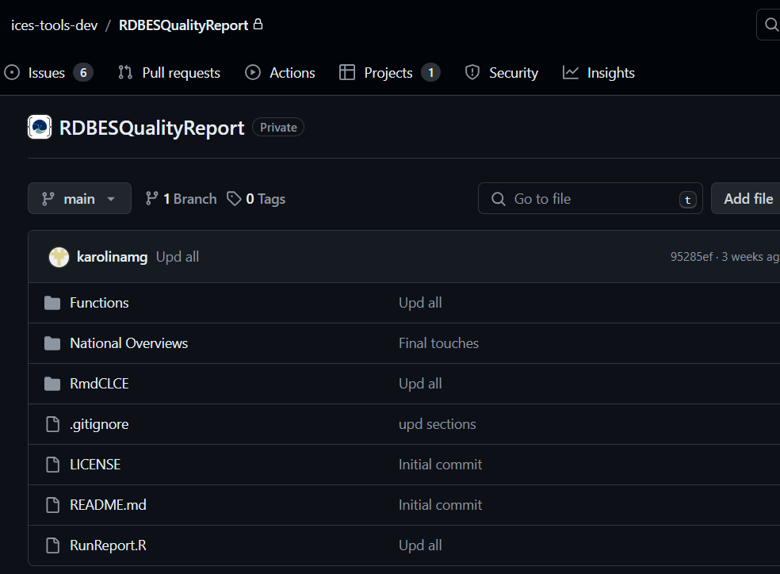
TASK 2: To start developing further the Data Quality report for data submitters
Quality report (currently only for CL & CE)
  Public ICES repository
  User can download the code and run the report
  Optional use of auxiliary data (Eurostat, ICES preliminary catches, Fleet register)
  Spatial checks
  CL & CE cross checks
  Development ongoing
Feedback & development
  User will be able to open an issue in the repository

Slide 12
Plan for testing the quality script
The script was presented and discussed at EU Regional Coordination Group (RCG NANSEA & Baltic)
The group recommended MS to start running the markdown Quality script for CL and CE tables and give feedback to the WGRDBESGOV in November.
If issues are encountered, NC will be able to resubmit their data (in this case, it is important to notify Henrik about the resubmission).
A Teams meeting will be organized around October 22nd (to be confirmed) to explain how to run the code and a follow up meeting.

Slide 13
Questions?

